Slide 1
Chapter 3: The Procurement Process

Slide 2
Outline
A Basic Procurement Process (manual process)
Role of Enterprise Systems in the Procurement Process
Exercise Using Simulated SAP

Slide 3
A Basic Procurement Process
Definition
  Requisition to pay
  All the steps needed to acquire/procure material
Key Concepts and Assumptions
  B2C vs. B2B commerce
  Importance of standardized processes in B2B
Conceptual Framework
  Physical Flow
  Document and Data Flow
  Information Flow
  Financial Impact

Slide 4
Physical Flow
What is the trigger?
What are the steps?
What is the purpose of each step?
Who is involved in each step?
How is communication and coordination accomplished

Slide 5
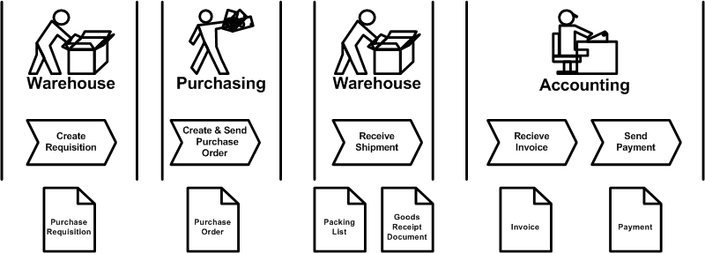
Physical Flow

Slide 6
Document flow
Purchase Requisition
Purchase Order
Packing List
Goods Receipt Document
Vender Invoice and Payment
Key questions regarding documents
  What is the purpose?
  What are the key data?
    General: Who, when, what, where
    Process / step specific: varies
  How does data change across the process?
  Who is responsible for the data?

Slide 7
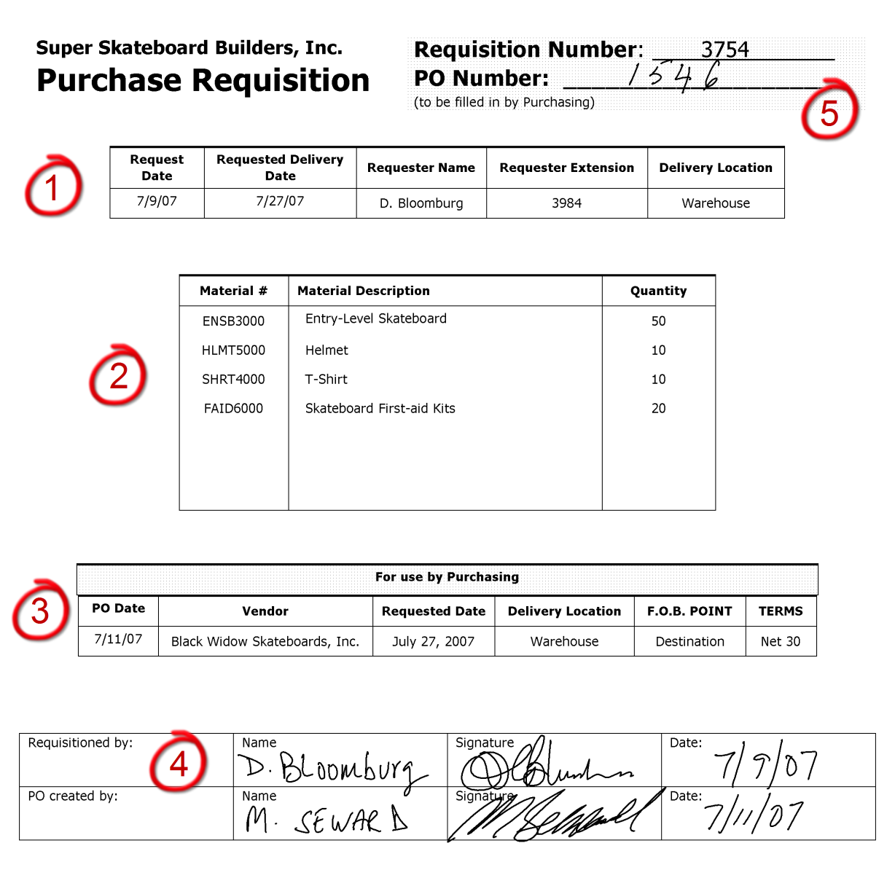
Purchase Requisition

Slide 8
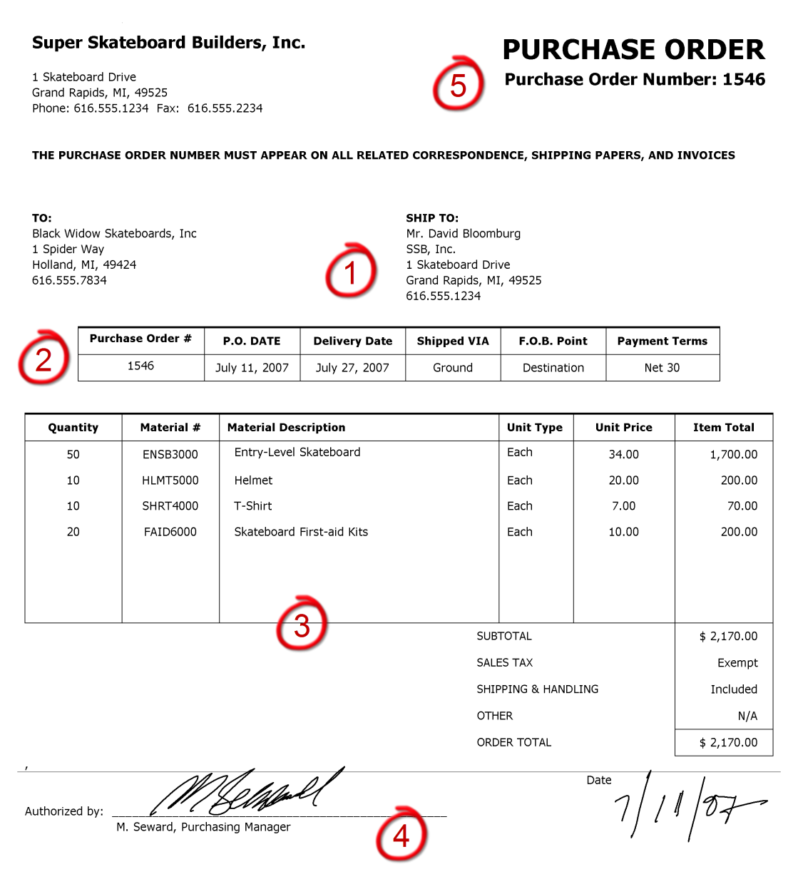
Purchase Order

Slide 9
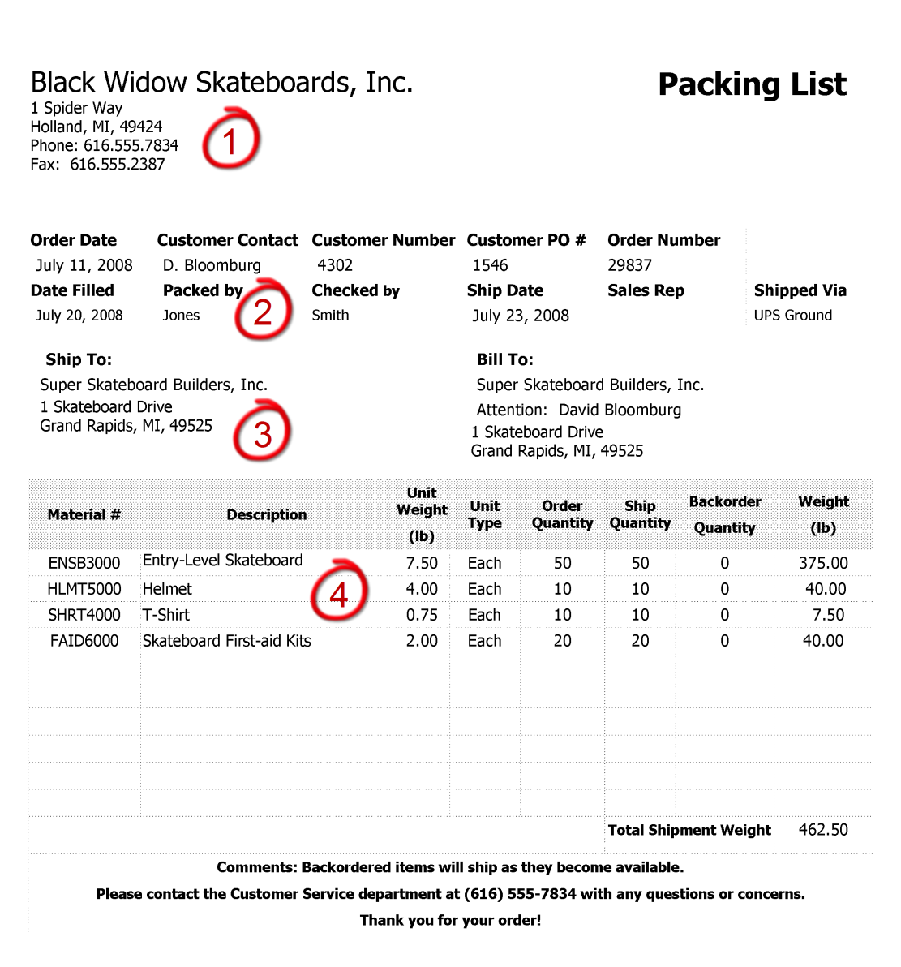
Packing List

Slide 10
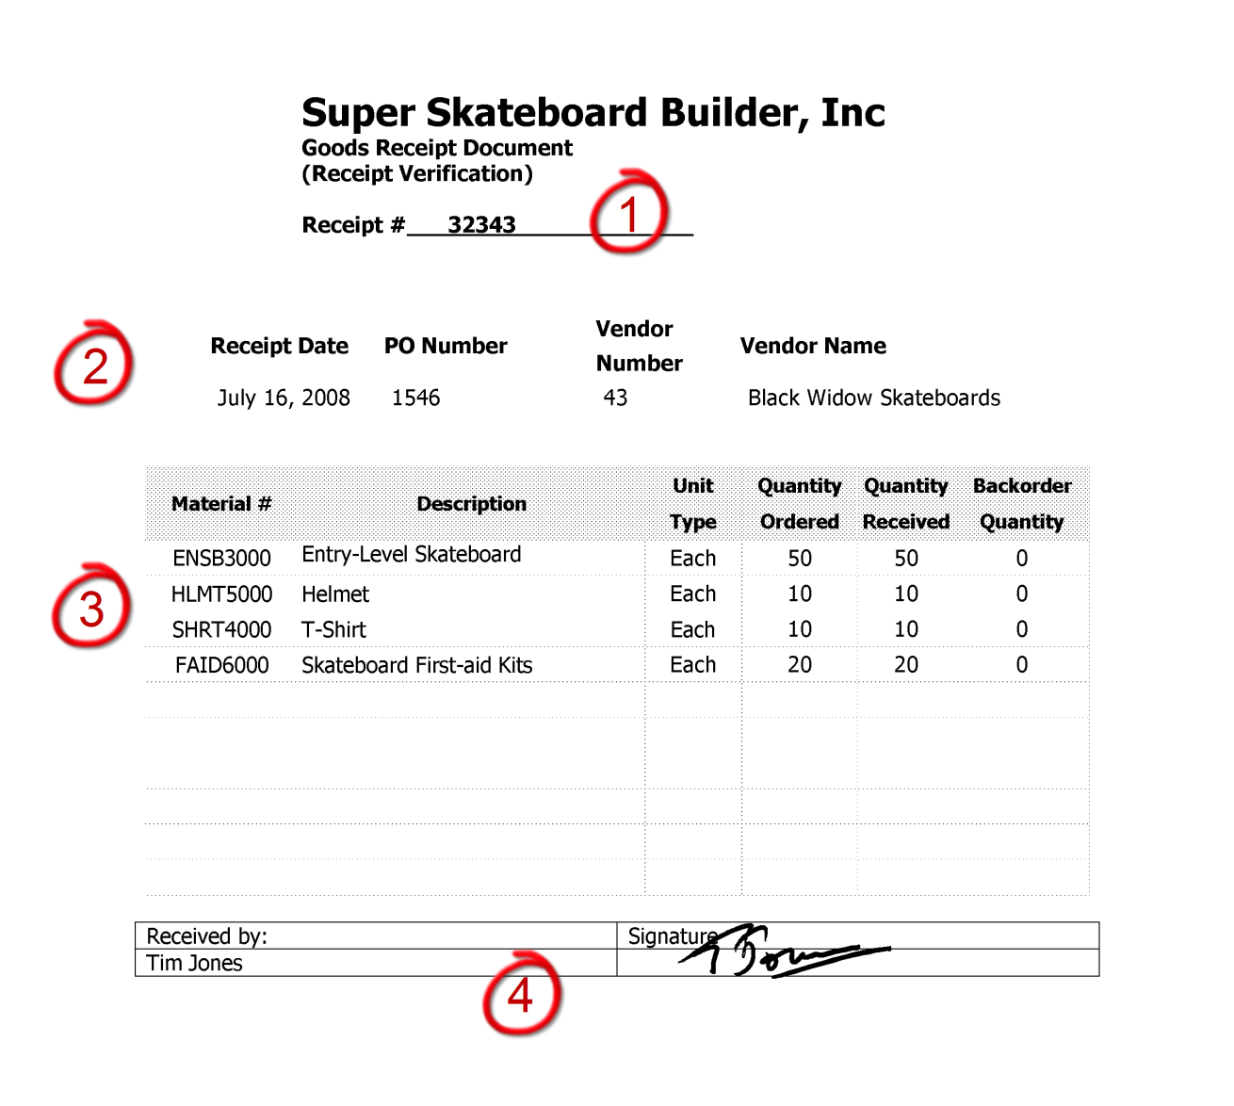
A Goods Receipt Document

Slide 11
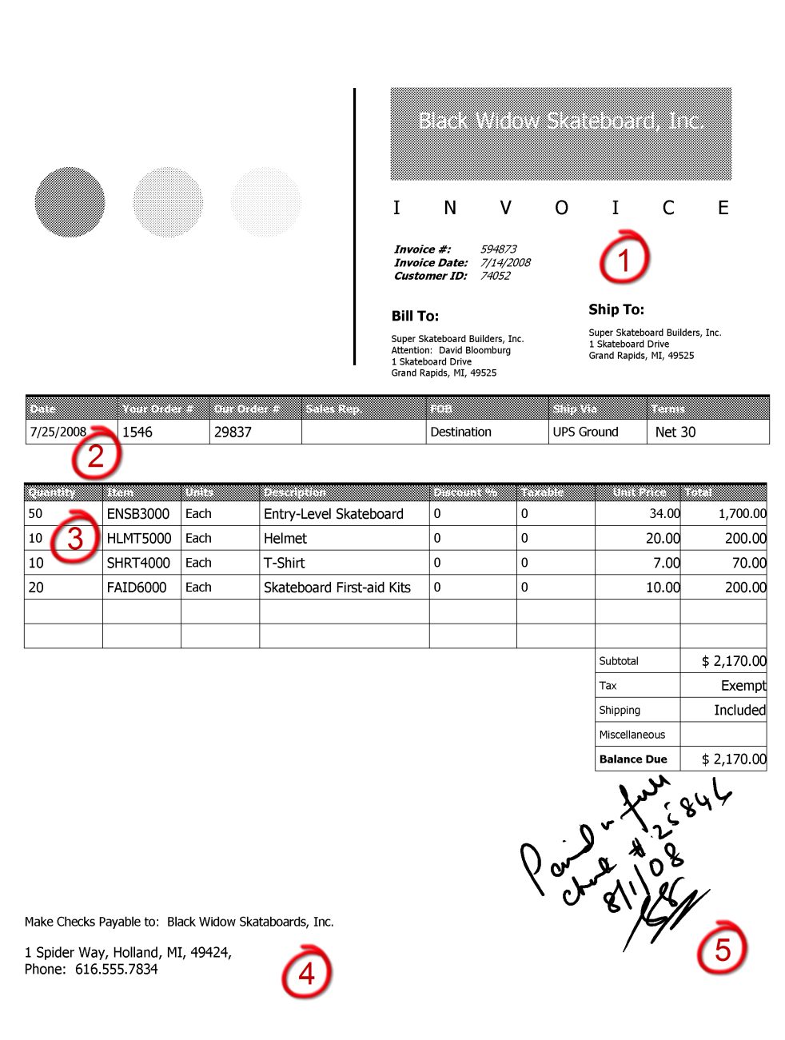
A Vender Invoice

Slide 12
Information Flow
Instance-Level Information
  Status of a purchase requisition / order
  Has a requisition been acted on? Has a PO been created and sent
  Have goods been received for the requisition / order? When? Where are the goods?
  If received, has an invoice been received? Paid?
  If not received, when can we expect the goods?
Process-Level Information
  How well is the process doing?
  How much time does it take on average? Per material? Per vendor?
  Which vendors are prompt? Who habitually delivers late?
  What do we buy most often? From with vendor(s)?

Slide 13
Financial Impact
Impact on balance sheet and income statement accounts
Example: Procure $500 in materials.
Process step | B/S | I/S
Purchase requisition
Purchase order
Goods receipt
Vendor Invoice receipt
Vendor payment

Slide 14
Role of enterprise systems in the procurement process
Execute the Process
  Create Purchase Requisition
  Create Purchase Order
  Receive Shipment
  Receive Invoice and Send Payment
Capture and Store Process Data
Monitor the Process
  Instance-Level Information Flow
  Process-Level Information Flow

Slide 15
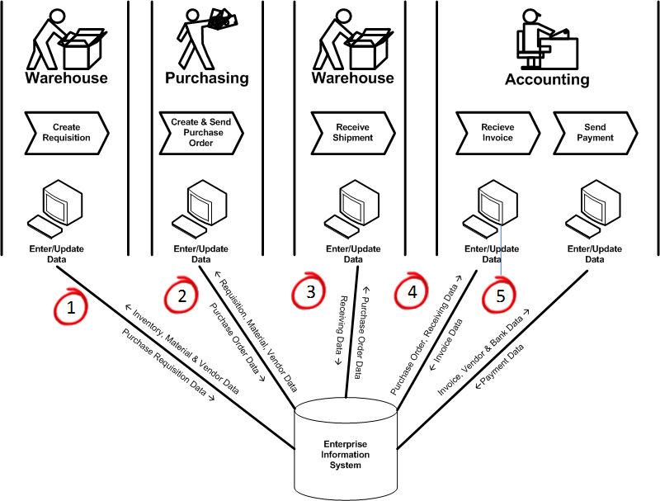
Enterprise systems in Procurement

Slide 16
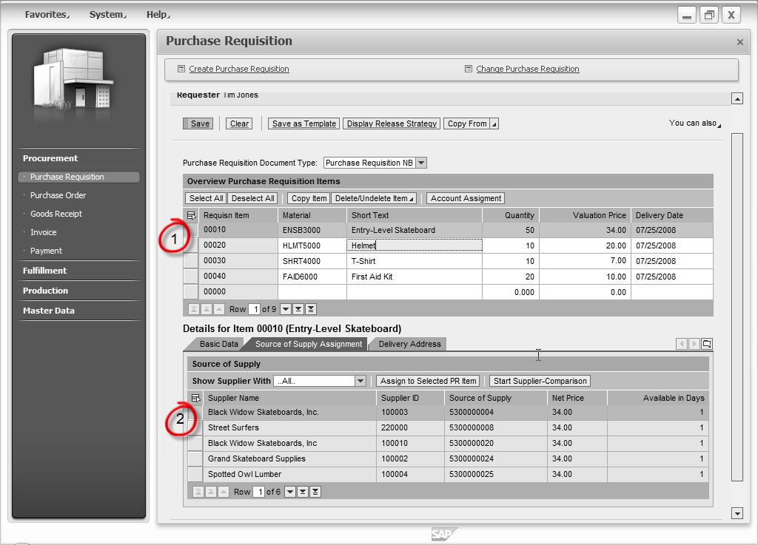
Purchase Requisition in SAP

Slide 17
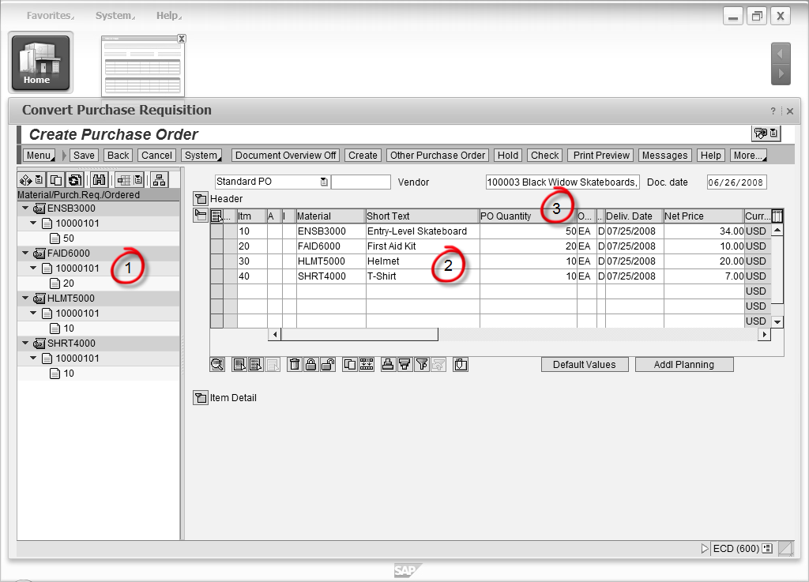
Purchase Order in SAP

Slide 18
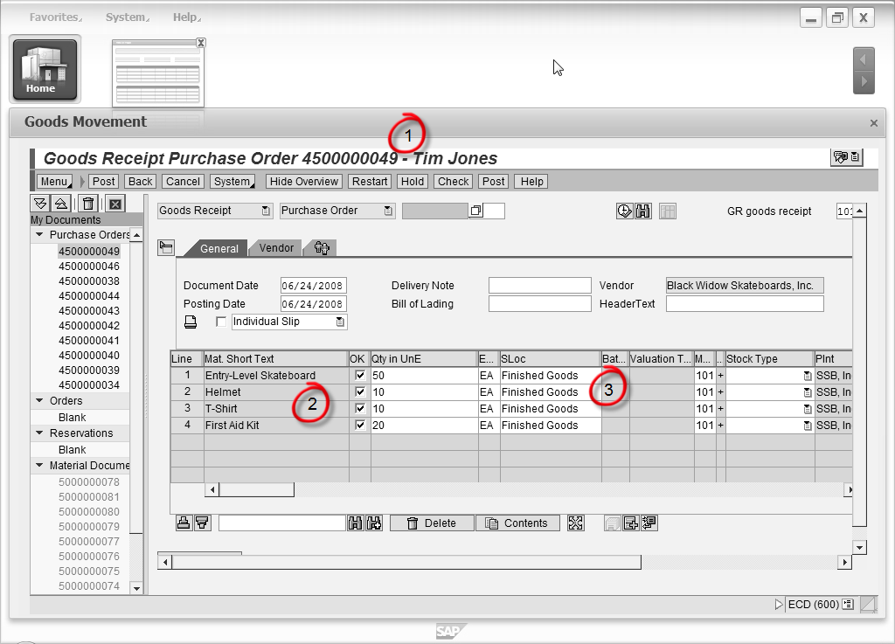
Goods Receipt in SAP

Slide 19
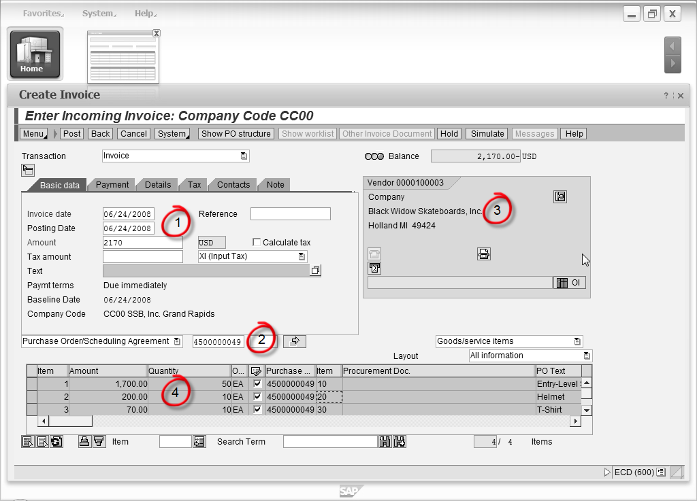
Invoice Receipt in SAP

Slide 20
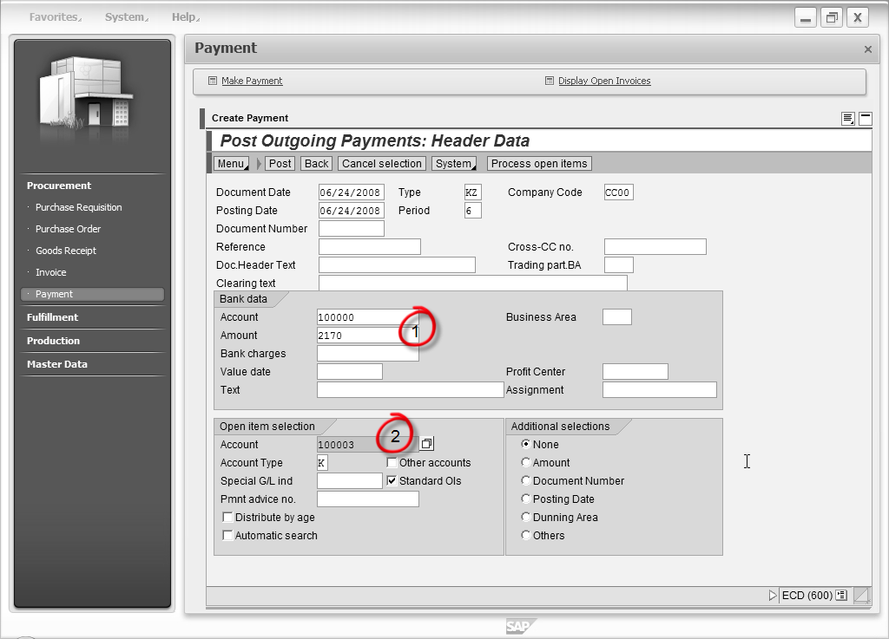
Vender Payment in SAP – Initial Screen

Slide 21
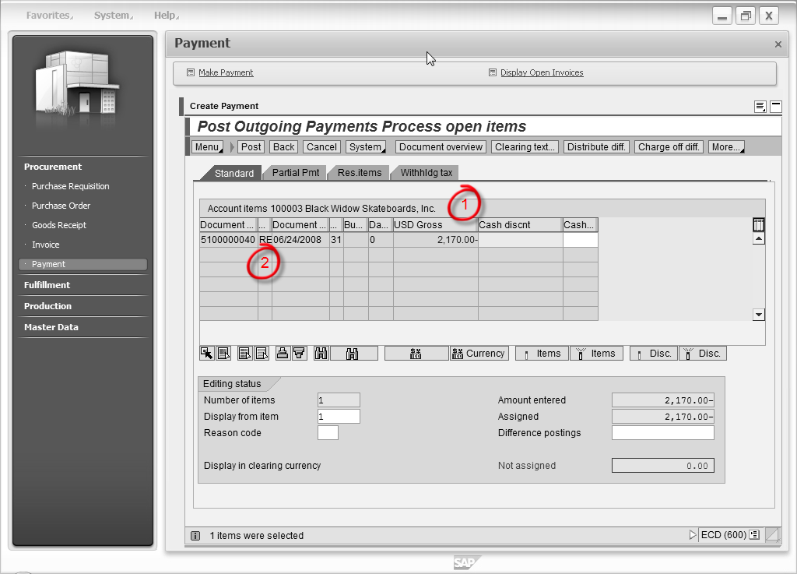
Vender Payment in SAP – Processing

Slide 22
Process monitoring (Information flow)
Instance level – status information
  Status of a purchase requisition / order (PO history)
Process level – aggregate information
  How is the process doing?

Slide 23
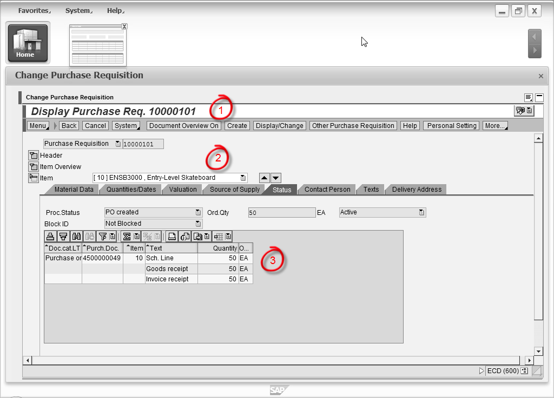
Purchase Requisition History

Slide 24
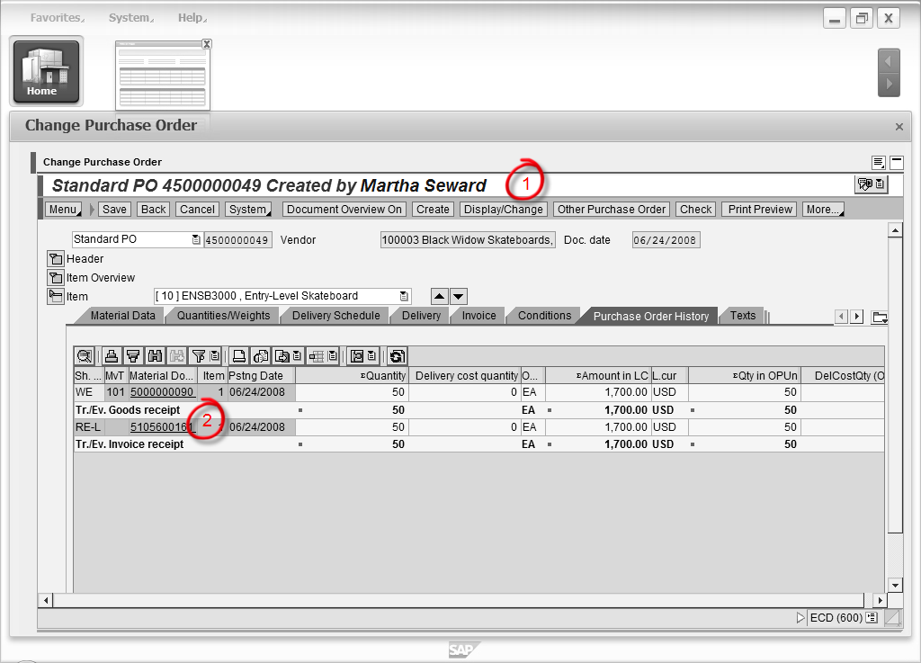
Purchase Order History

Slide 25
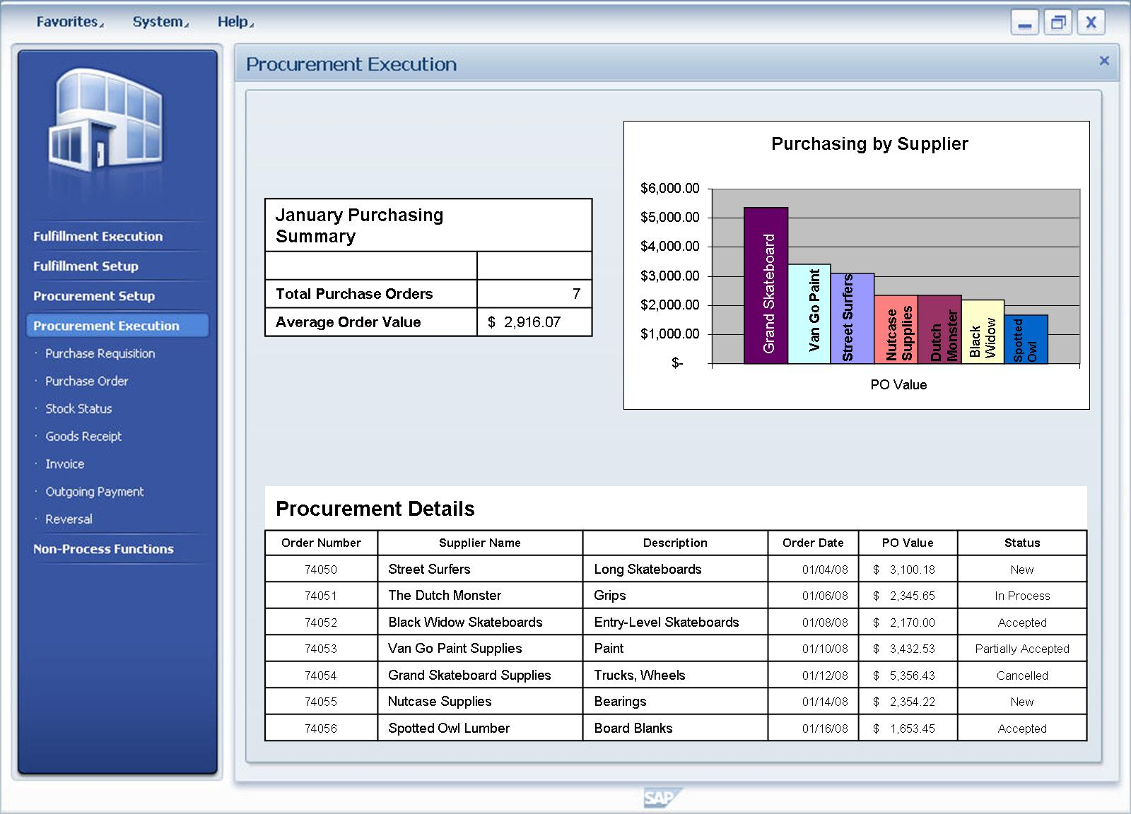
Process-Level Information

Slide 26
Exercise Using Simulated SAP
The exercises will require you to complete the steps in the procurement process that have been discussed in this chapter. In particular you will:
  Create a purchase requisition for a number of trading goods
  Convert the requisition to a purchase order
  Enter a goods receipt into the system
  Enter a vendor invoice into the system
  Record a payment to the vendor

